Slide 1
Hand Sign Detection Using Artificial Intelligence

Slide 2






Content
Introduction
Abstract
Methodology
Experimental Results
Conclusion
References
Thank You

Slide 3

Abstraction
Automated gesture recognition involves abstracting relevant features from hand sign images using machine learning algorithms. This process allows the model to discern intricate patterns for accurate detection.

Slide 4

Methodology
The methodology encompasses data collection, preprocessing, and the utilization of machine learning algorithms for model training. Feature engineering plays a crucial role in extracting essential elements for accurate hand sign detection.

Slide 5
Experiment Result
The experiment demonstrates the efficacy of the machine learning model with impressive results. Key metrics such as accuracy, precision, recall, and F1-score showcase the model's proficiency in recognizing diverse hand signs.

Slide 6

Conclusion
The project concludes that employing artificial intelligence for hand sign detection is a transformative approach, automating the process with increased precision. The potential impact spans communication, human-computer interaction, and accessibility.

Slide 7
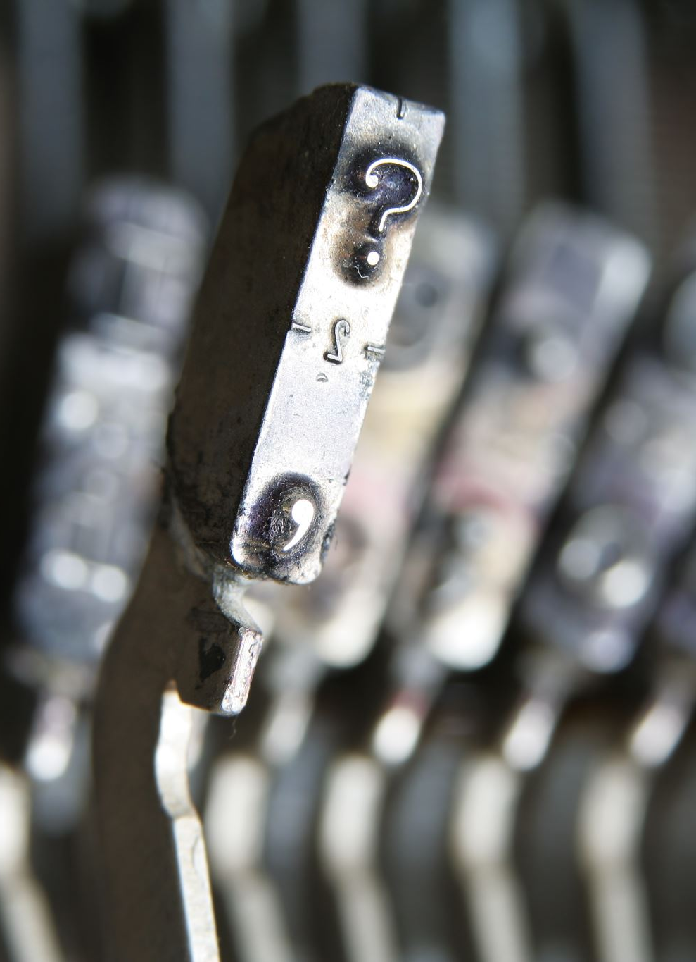
References
[Include specific references pertinent to image processing and machine learning for gesture recognition.]

Slide 8
Thank You!
Any Questions or Further Discussions?

